Slide 1
Clustering

Slide 2
Definition
Clustering is another application of our fundamental notion of similarity. The basic idea is that we want to find groups of objects (consumers, businesses, whiskeys, etc.), where the objects within groups are similar, but the objects in different groups are not so similar.

Slide 3
Kmeans
K refers to the number of clusters we want to find.
Distance and similarity based clustering algorithm.

Slide 4
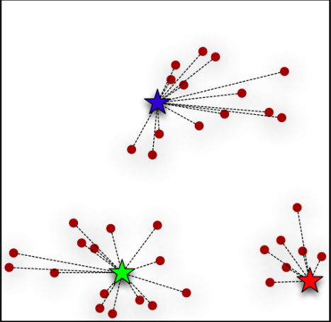
Kmeans for k=3 (Step 1)
Initialize k random points (which are going to act as centers for us).
The first step of the k-means algorithm: find the points closest to the chosen centers (possibly chosen randomly). This results in the first set of clusters.

Slide 5
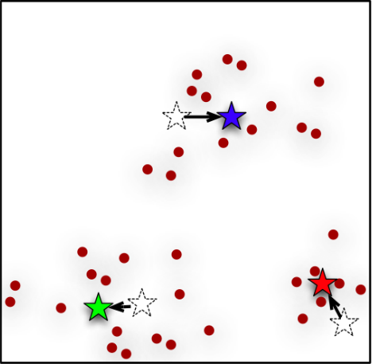
Kmeans for k=3 (Step 2)
The second step of the k-means algorithm: find the actual center of the clusters found in the first step.

Slide 6
Kmeans for k=3 (Step 3: Iteration)
The process simply iterates: since the cluster centers have shifted, we need to recalculate which points belong to each cluster (as in Figure in Step 1). Once these are reassigned, we might have to shift the cluster centers again. The k-means procedure keeps iterating until there is no change in the clusters (or possibly until some other stopping criterion is met).

Slide 7
Identifying the hyperparameter k in kMeans
Elbow Method for optimal value of k in KMeans (using 'Distortion' and 'Inertia' and not with explainable variance)
Using the "elbow" or "knee of a curve" as a cutoff point is a common heuristic in mathematical optimization to choose a point where diminishing returns are no longer worth the additional cost.
A fundamental step for any unsupervised algorithm is to determine the optimal number of clusters into which the data may be clustered. The Elbow Method is one of the most popular methods to determine this optimal value of k.
We now define the following:
Distortion: It is calculated as the average of the squared distances from the cluster centers of the respective clusters. Typically, the Euclidean distance metric is used.
Inertia: It is the sum of squared distances of samples to their closest cluster center.

Slide 8
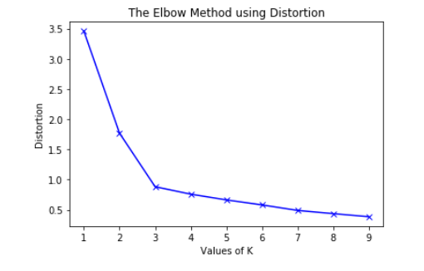
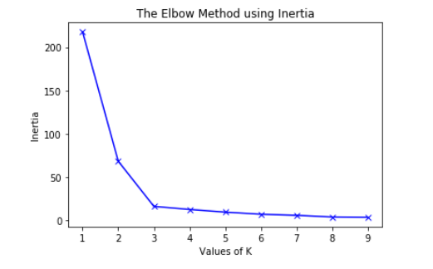
We build models for incrementing values of k till we find the right value.

